Slide 1
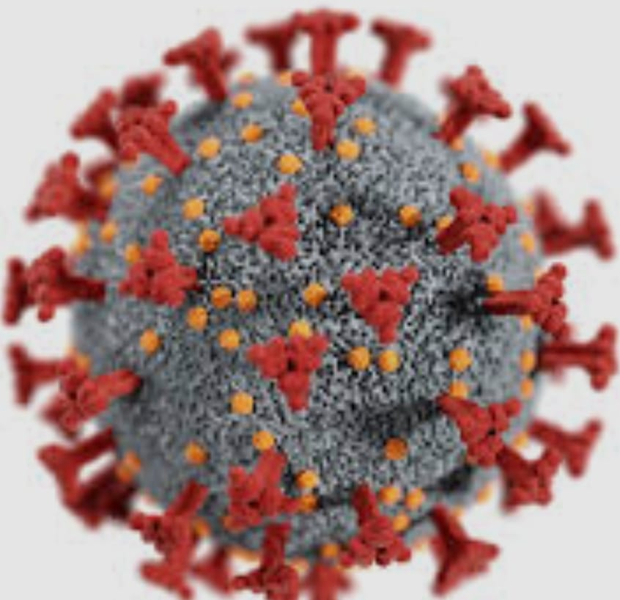
Proxenix Company Internship
GROUP NUMBER 51 DETAILS
Trainee Name
Priyanka (team leader)
Poonam Baghel
Purnansha Sahu
Nandani

Slide 2
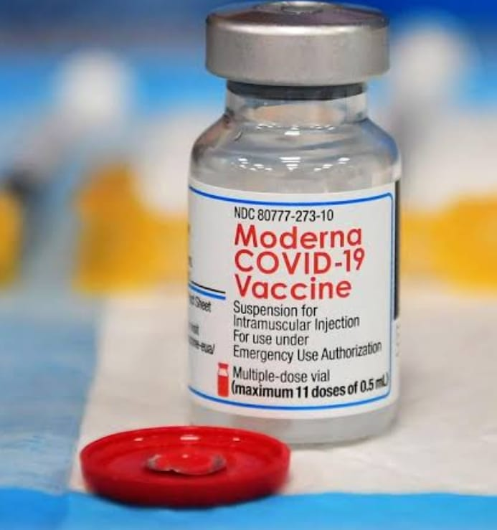
GLOBAL COVID -19 DATA ANALYIS

Slide 3
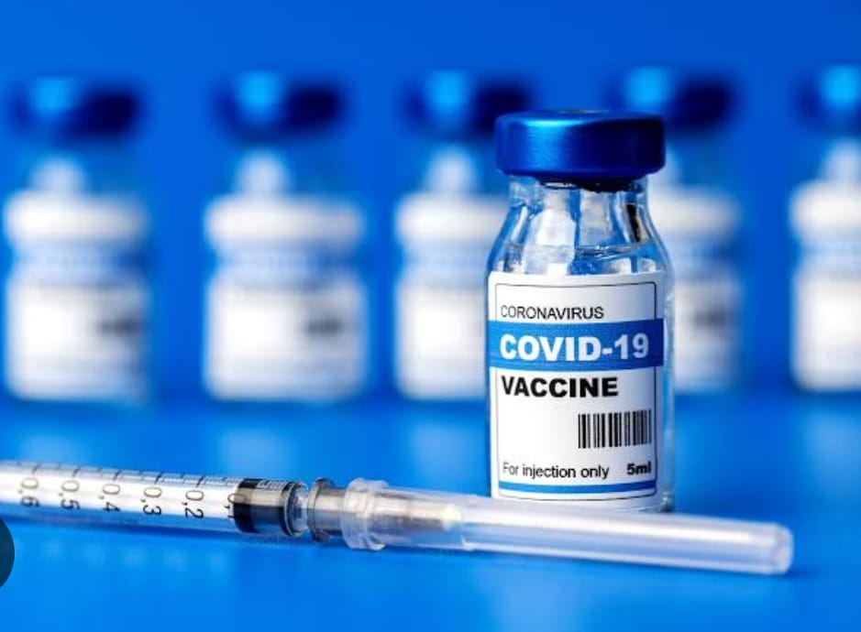
TOPICS
Overview of covid - 19
Vaccination Rollout Analysis
Recovery Rate Analysis
Impact on Global Economy
Positivity Rate Analysis
Lockdown Impact Analysis
Hospital infrastructure & Capacity data
Mental health data analysis
Global misinformation & Social media trends

Slide 4
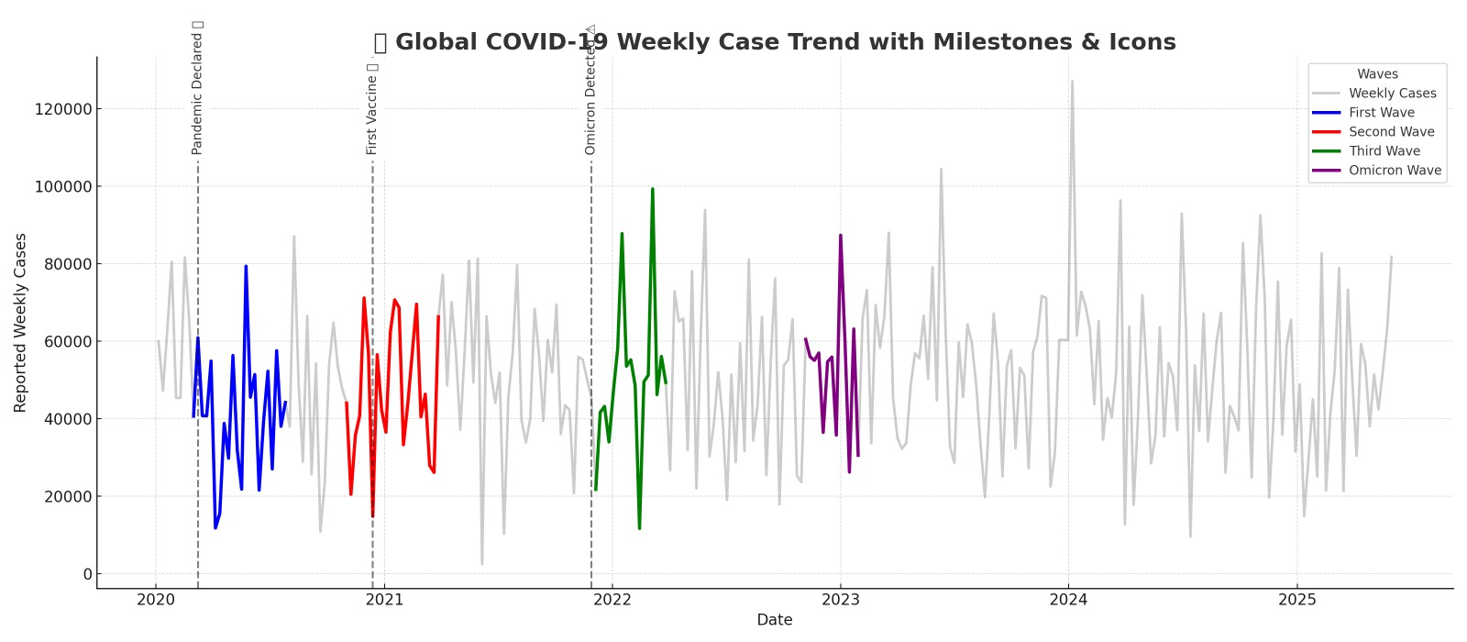
Introduction to covid-19
Covid - 19 also known as the corona virus disease caused by a newly discovered virus called SARS-CoV-2 (Severe Acute Respiratory Syndrome Corona virus 2). The disease was first identified in wuhan, China, in December 2019, and quickly spread across the world, leading to a global pandemic declared by the World health Organization(WHO) on 11 march, 2020.
Covid -19 primarily spreads through respiratory droplets when an infected person coughs, sneezes, or breathes. It can also spread by touching surfaces contaminated with the virus and then touching the face, especially the mouth, nose or eyes.

Slide 5
Vaccination Rollout Analysis
The vaccination rollout is a critical public health initiative aimed at achieving widespread immunity against infectious diseases, particularly COVID-19. This analysis focuses on the pace, coverage, challenges and impact of the vaccination program.
ROLLOUT PAHSES
Phases 1: Frontline health workers and Essential services.
Phases 2: elderly (60+yrs) and high- risk individuals.
Phases3: General adult population.
Phases4: Adolescents and Children (if applicable ).
Booster / Revaccination Campaigns (if applicable).

Slide 6
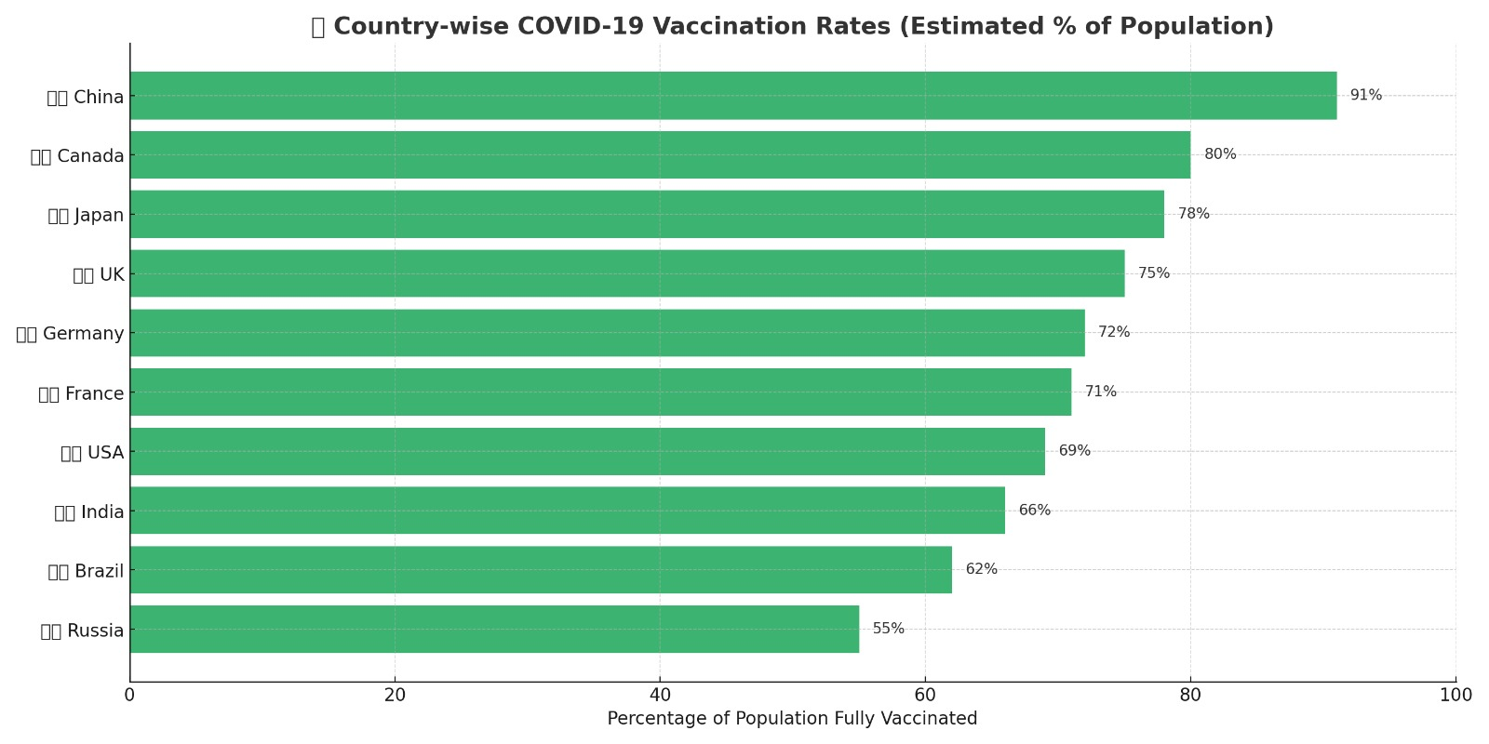

Slide 7
RECOVERY RATE ANALYSIS
Concept: Age-wise COVID-19 Case Distribution Chart
Let’s imagine the following age groups:
0-17, 18-30, 31-45, 46-60, 60+
We'll show 3 bars per age group:
🟦 Active cases
🟩 Recovered cases
🟥 Deceased cases

Slide 8
Bar chart
10000 ─────────────────────────
| ┌───┐
| │⬛⬛│ ┌───┐
| ┌───┐ │🟩🟩│ │🟥🟥│
| │🟦🟦│ │🟩🟩│ │🟥🟥│
| │🟦🟦│ │🟩🟩│ │🟥🟥│
└─────────────────────
18–30 31–45 46–60 60+
Age Groups

Slide 9
Brief Explanation
Young age group (18-30) :
High Active Recovered and cases
Very low death ratio due to ratio due to stronger immunity.
Middle age ( 31 -45 & 46 -60) :
Moderate recovery , but slightly higher fatalities due to comorbidties.
Senior citizens (60+) :
Lower recovery , higher deceased cases , especially in males.
Immune system vulnerability shows in higher death ratio.

Slide 10
Impact on Global Economy
1. GDP Drop & Recovery (2020 vs 2021)
In 2020, all countries faced economic contraction.
In 2021, a strong recovery is seen — especially in India (8.7%) and UK (7.4%).
2. Sector - wise losses
The Travel sector faced the highest loss ($935 billion), followed by Retail and Education sectors.
3. Unemployment Rise
The USA and Canada saw the sharpest rise in unemployment .
India also experienced a significant increase (2.6%).
4. Economic Aid Packages (% of GDP)
Japan (42%) and Germany (39%) offered the largest stimulus packages. India’s aid was about 10% of its GDP.

Slide 11
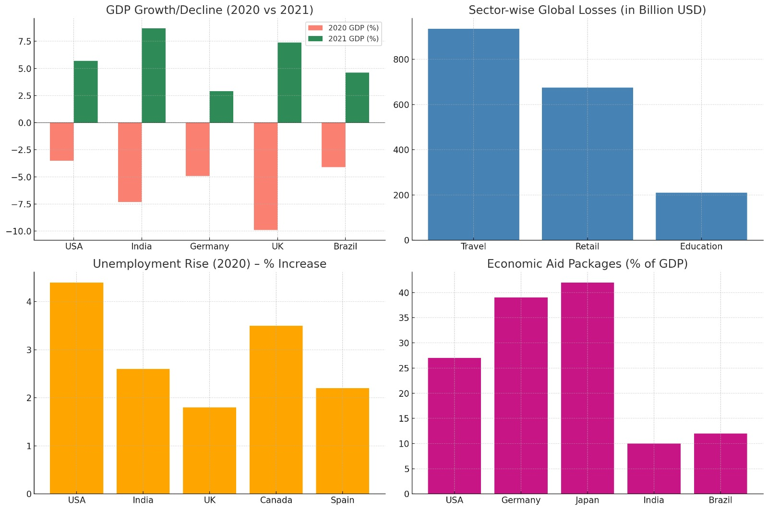
Economic Data Study Chart pack- covering 4 key areas

Slide 12
Positivity Rate Analysis
Positivity rate refers to the percentages of all COVID -19 tests (or the other disease tests ) that return positive results . It is a key indicator of the disease transmission, testing adequacy, and potential underreporting.
Formula:
Positivity Rate = (Positive Cases ÷ Total Tests) × 100
Why is important ?
Detects infection level in a population.
Helps identify hotspot areas.
Tells if testing is sufficient.
Guides healthcare planning and control measures.

Slide 13
How to Analyze?
1. Line or Bar Chart
X-axis: Date or Region
Y-axis: Positivity Rate (%)
Show weekly/monthly trend
2. Color Codes:
🟢 0–5% → Safe
🟡 5–10% → Moderate Risk
🔴 >10% → High Risk
3. Use Moving Average
Shows smooth trend (like 7-day average)

Slide 14
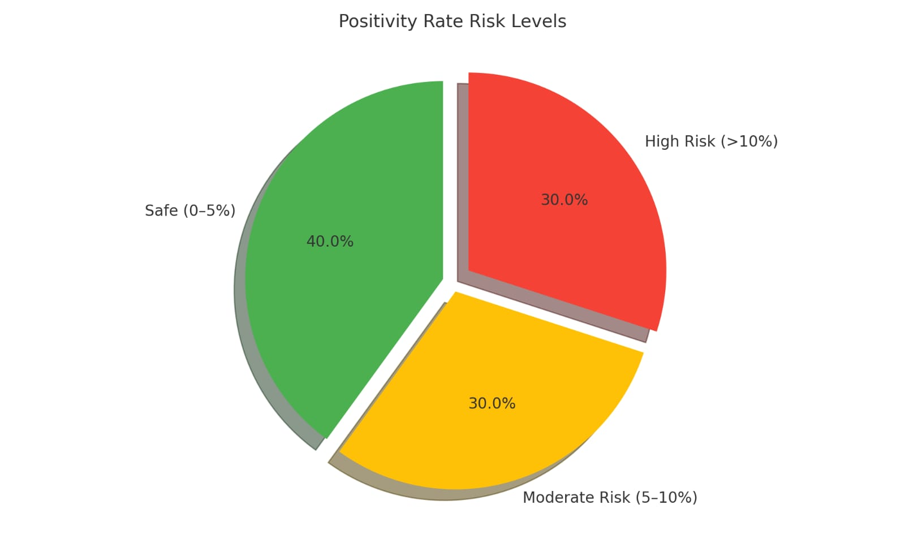
How to Interpret?
Rate Meaning
0–5% Testing is good, spread under control
5–10% Caution needed, increase testing
10%+ Dangerous, virus spreading fast

Slide 15
Lockdown Impact Analysis
1. Economic Impact
Job losses and rise in unemployment
Fall in GDP and business shutdowns
MSMEs suffered the most
Rise in online economy (e-commerce, digital payments)
2. Social Impact
Migrant worker crisis
Mental health issues due to isolation
Disruption in education (schools closed)
Domestic violence cases increased

Slide 16
3. Environmental Impact
Air and water quality improved
Wildlife movement increased
Reduction in industrial pollution
4. Health Impact
Slowed down COVID spread
Healthcare system got time to prepare
Non-COVID treatments delayed

Slide 17
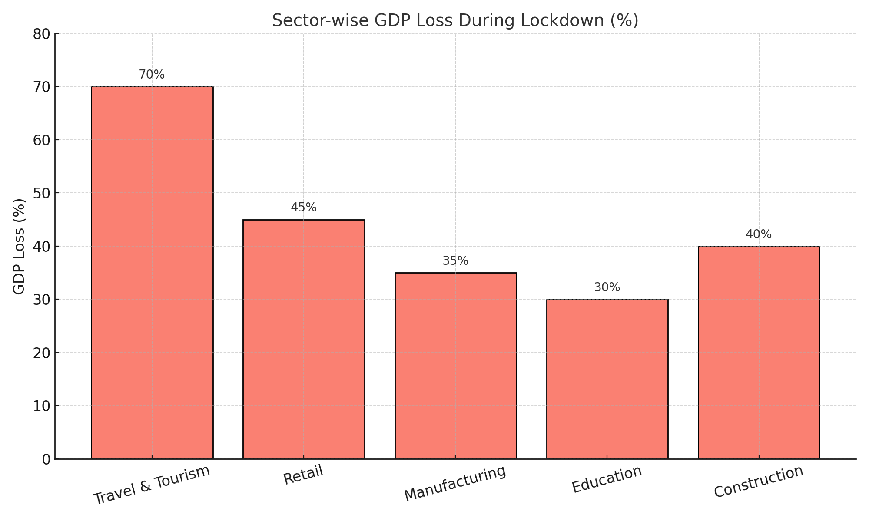

Slide 18
Hospital Infrastructure & Capacity data
Objective:
To compare healthcare readiness of major Indian states during a health crisis like COVID-19
Key Metrics Compared:
Total Beds – Overall hospital beds (general + ICU)
ICU Beds – Critical care support
Ventilators – Life support systems for severe respiratory cases
Chart Explanation:
States Analysed:
Maharashtra
Uttar Pradesh
Tamil Nadu
Karnataka
Delhi

Slide 19
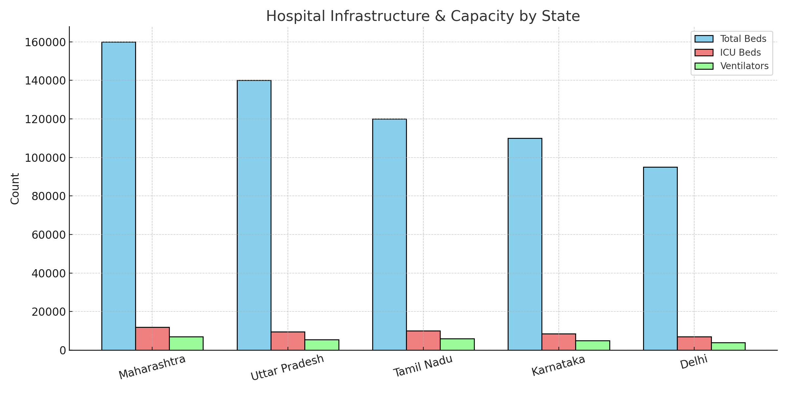
Findings:
State | Total Beds | ICU Beds | Ventilators
Maharashtra | 160,000 | 12,000 | 7,000
Uttar Pradesh | 140,000 | 9,500 | 5,500
Tamil Nadu | 120,000 | 10,000 | 6,000
Karnataka | 110,000 | 8,500 | 5,000
Delhi | 95,000 | 7,000 | 4,000

Slide 20
Insights:
Maharashtra leads in all three capacities, showing higher readiness.
Tamil Nadu has a higher ICU-to-bed ratio, indicating better emergency care readiness.
Delhi, though smaller in area, maintains strong capacity relative to size.
Uttar Pradesh has high total beds but comparatively fewer ICU and ventilators per capita.
Conclusion:
Hospital infrastructure is unevenly distributed across states. Investment is needed in:
Increasing ICU beds & ventilators
Strengthening rural healthcare systems
Real-time monitoring of hospital capacity during pandemics

Slide 21
Mental Health Data Analysis
Mental health data analysis is the process of collecting, studying, and interpreting data related to people’s emotional and psychological well-being.
Objective:
To understand how the COVID-19 pandemic affected people's mental well-being — across age groups, genders, and professions.
Insights:
Students suffered due to uncertainty, online classes, isolation
Healthcare workers had highest stress due to workload and risk
Elderly felt isolated and anxious about health risks
Online therapy and helpline calls rose by over 80% during lockdown

Slide 22
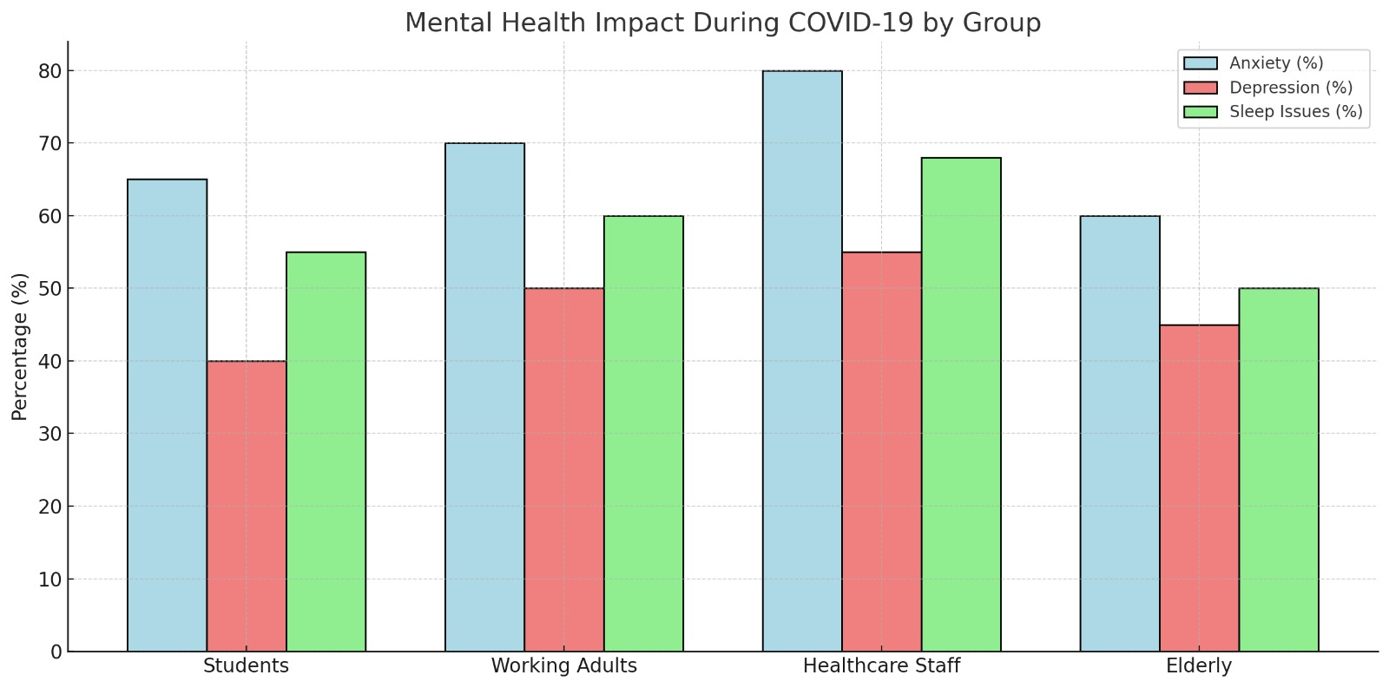
Chart Data
Group | Anxiety (%) | Depression (%) | Sleep Issues (%)
Students | 65% | 40% | 55%
Working Adults | 70% | 50% | 60%
Healthcare Staff | 80% | 55% | 68%
Elderly | 60% | 45% | 50%

Slide 23
Conclusion:
COVID-19 crisis triggered a parallel mental health pandemic. Governments and institutions need to:
Increase access to mental health support
Integrate counseling into schools and workplaces
Reduce stigma and promote awareness

Slide 24
Global Misinformation & Social Media Trends
Misinformation means false or misleading information that is shared without verifying its truth. When this kind of information spreads across countries and continents, it is called Global Misinformation.
Types of Misinformation:
Fake Cures: Neem, garlic, alcohol, UV lamps—sabke “miracle cure” claims viral hue.
Vaccine Myths:
“Vaccines cause infertility”
“Vaccines contain microchips”
Conspiracy Theories:
“5G towers spread COVID-19”
“Virus is man-made”
False Government Policies:
Fake lockdown notices or curfews circulated on WhatsApp and Facebook.

Slide 25
Social Media Trends During COVID-19 :
#StayHome Campaigns: Platforms promoted awareness (Facebook, Instagram filters).
Rise of Fact-Checkers: WHO & independent bodies collaborated with Twitter, FB, Google.
User Engagement Surge: Lockdowns led to a massive spike in screen time and content consumption.
Infodemic: WHO coined this term for the flood of information—both true and false.
Censorship vs. Freedom: Platforms struggled to balance between curbing false info and allowing free speech.
Impact of Misinformation :
Vaccine hesitancy
Panic buying & hoarding
Violence against health workers
Distrust in governments
Measures Taken :
Fact-check labels (Twitter, Facebook)
Removal of harmful content (YouTube bans)
Verified health sources (Google/Instagram redirection to WHO, MoHFW)
Digital literacy campaigns

Slide 26
THANK YOU

